Slide 1
DATA–X Price per night prediction in Prague
Team 3
Dominik Nováček
Juraj Šlauka
Richard Kalousek
Viktor Sívek
Vojtěch Neumann
Prague, April 2025

Slide 2
Data Preparation

Slide 3
Project definition
Price prediction = goal
Price distribution is skewed
Logarithm price to improve stability and normality of the model
Challenges addressed:
Missing values, outliers
Categorical encoding (room type, neighbourhood)
Feature selection and transformation

Slide 4
Data
Initial dataset: 10k rows, 79 features
Key preprocessing steps:
Removal of outliers (extreme prices, invalid entries)
Log-transformation of numeric values
Engineering features:
Amenities count
Text-based features (host verifications, description length)
Review metrics
Location grouping into neighbourhood_group
Result: Clean, feature-rich dataset suitable for modeling

Slide 5
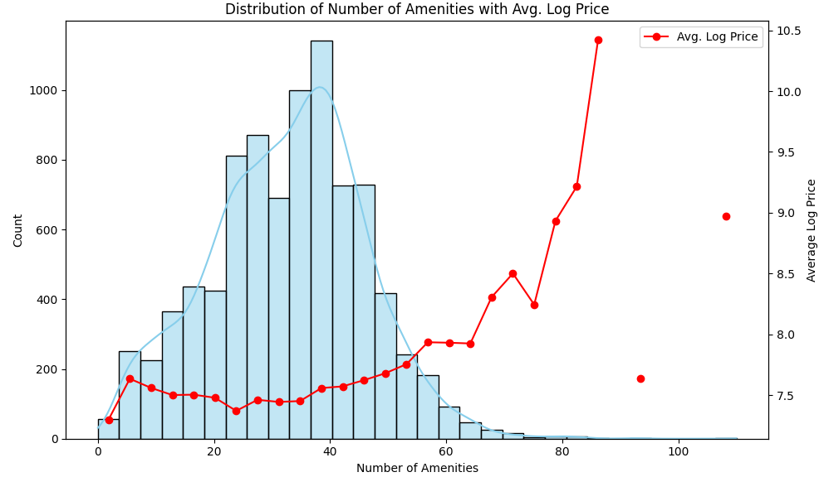
Data visualization

Slide 6
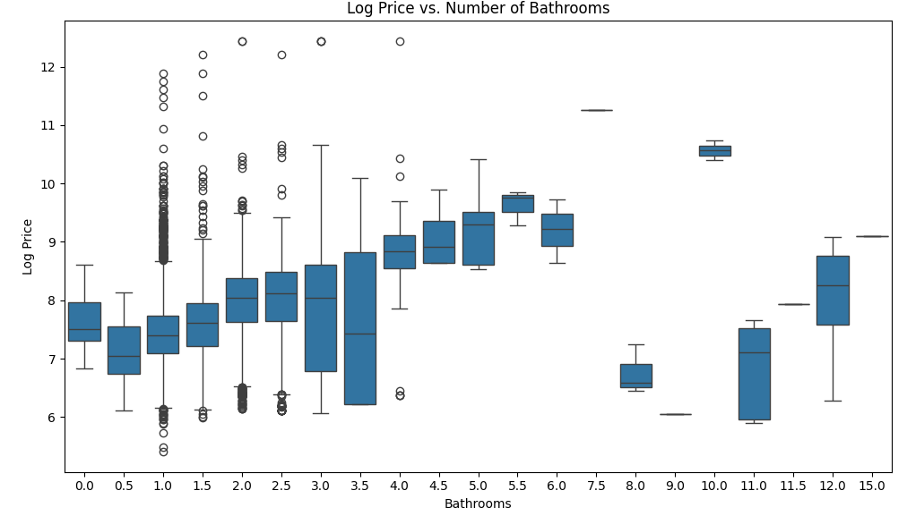
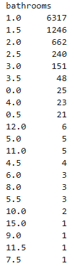
Data visualization

Slide 7
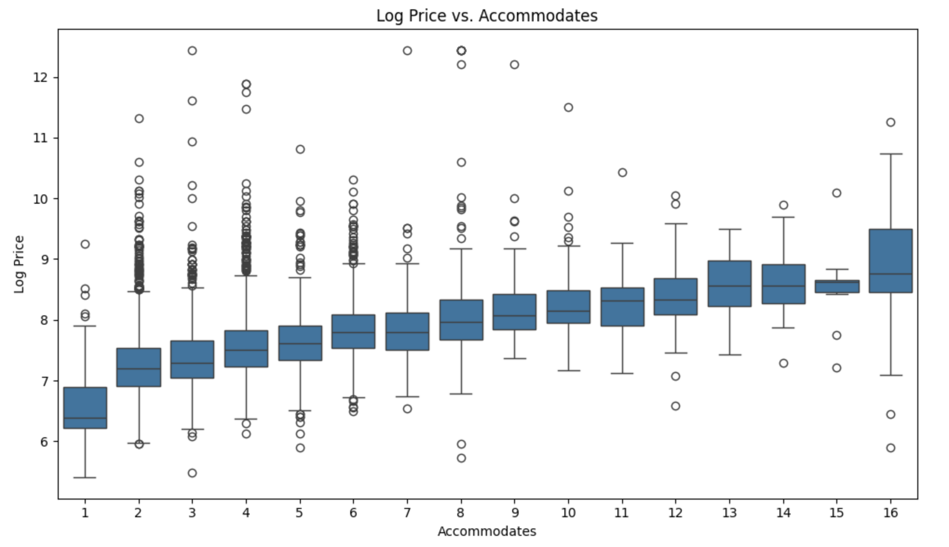
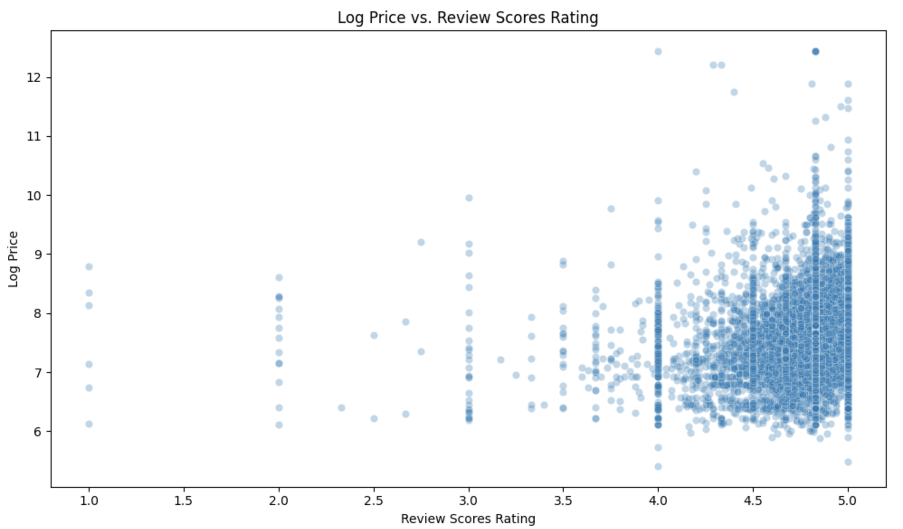
Results

Slide 8
Model & Metrics
Models evaluated:
Linear Regression
Decision Tree Regressor
XGBoost
Metrics used:
Root Mean Squared Error (RMSE)
R² (coefficient of determination)
Evaluation strategy:
Train/test split (70/30)
Learning curve analysis
Metric comparison across models
Model | Mean CV RMSE | Std Dev
LightGBM | 0.3769 | 0.0143
XGBoost | 0.3883 | 0.0155
Random Forest | 0.3996 | 0.0083
Ridge | 0.4466 | 0.0202
Lasso | 0.6663 | 0.0152

Slide 9
RESULTS

Slide 10
Results
Final model: XGBoost
Performance on test set:
RMSE: 0.31
R²: 0.624
Interpretation:
Model generalizes well
Handles nonlinear relationships
Robust to multicollinearity and noise

Slide 11
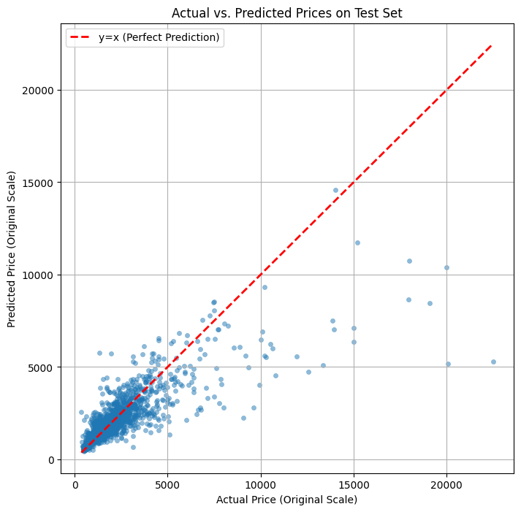
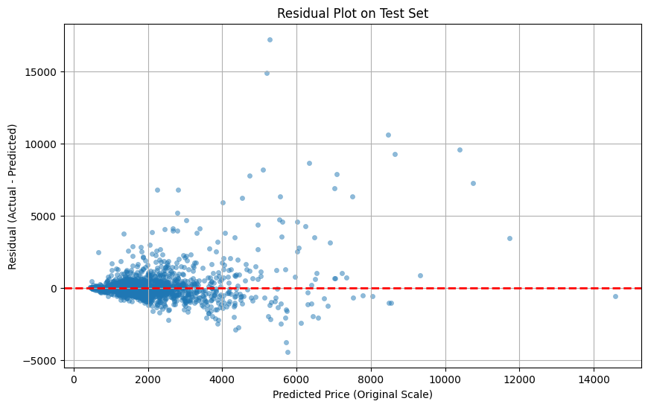
Results

Slide 12
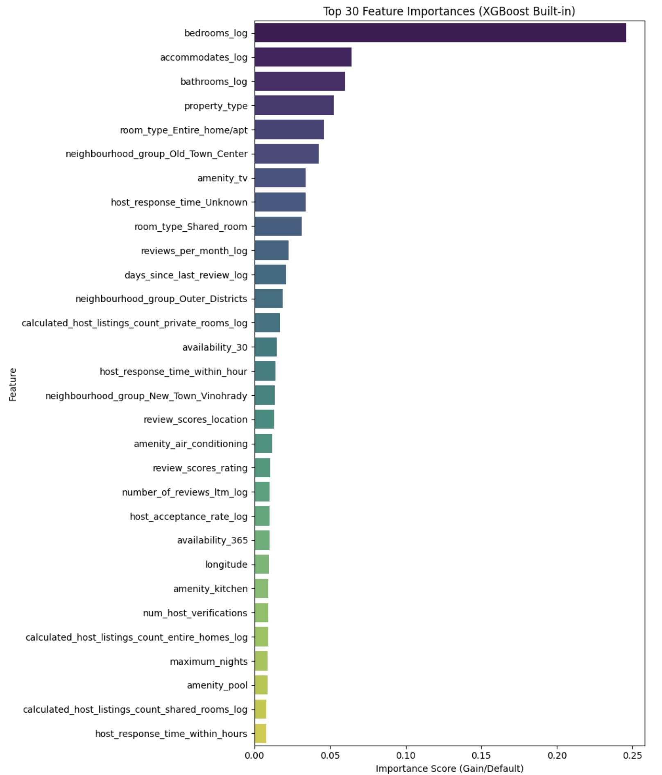
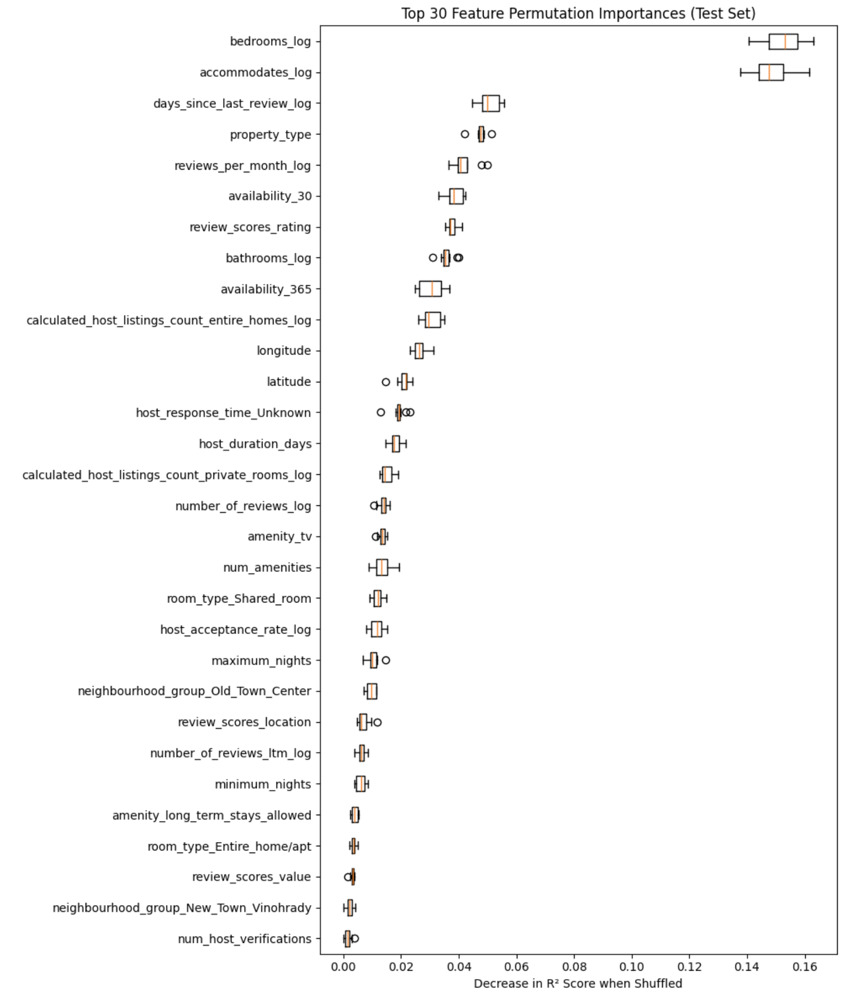
Feature importance

Slide 13
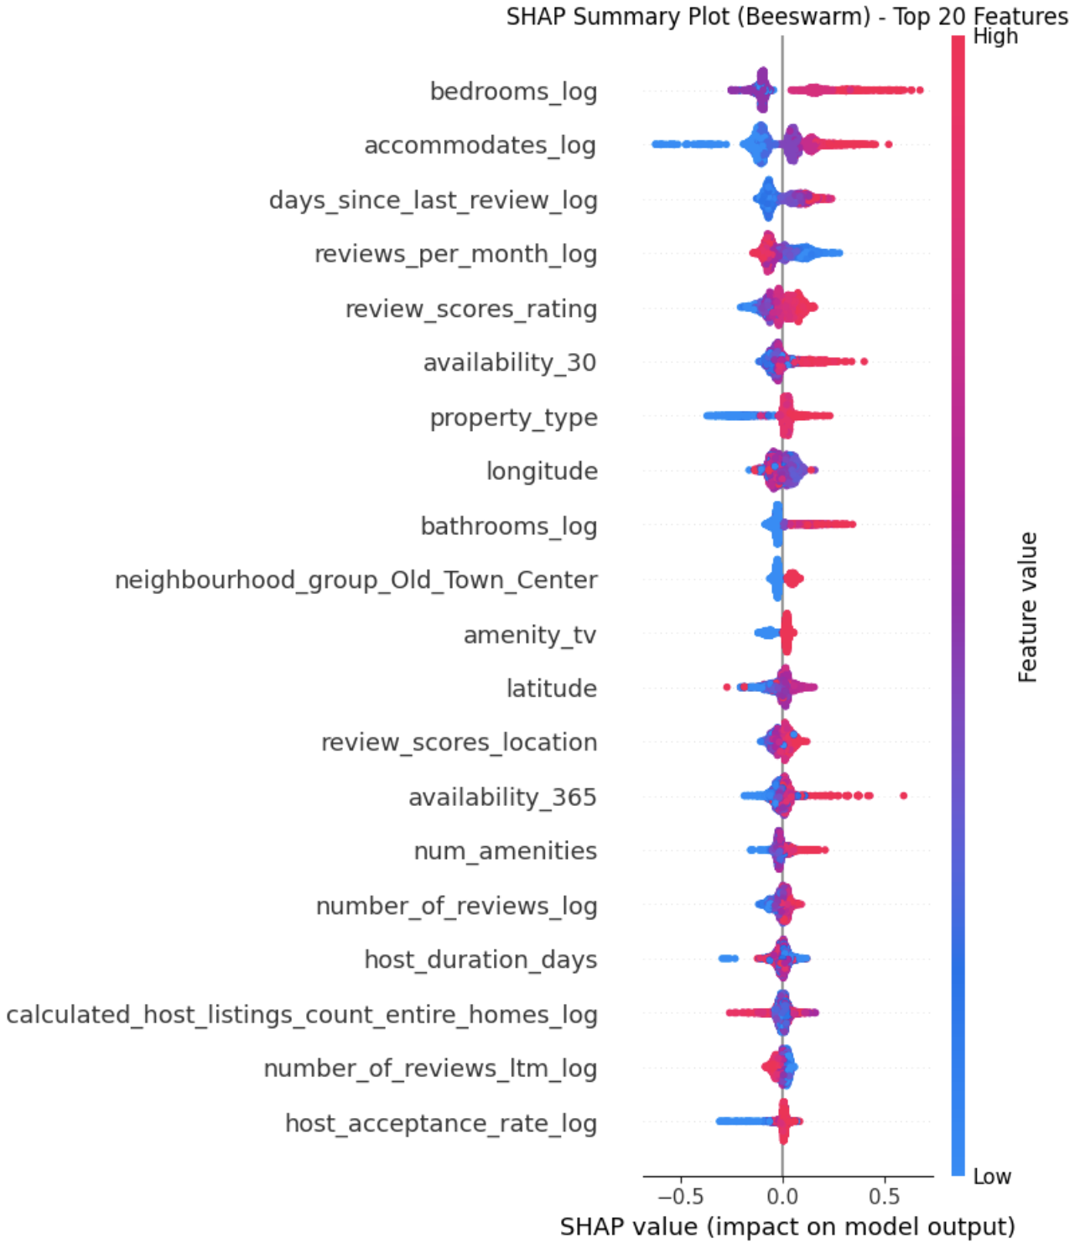
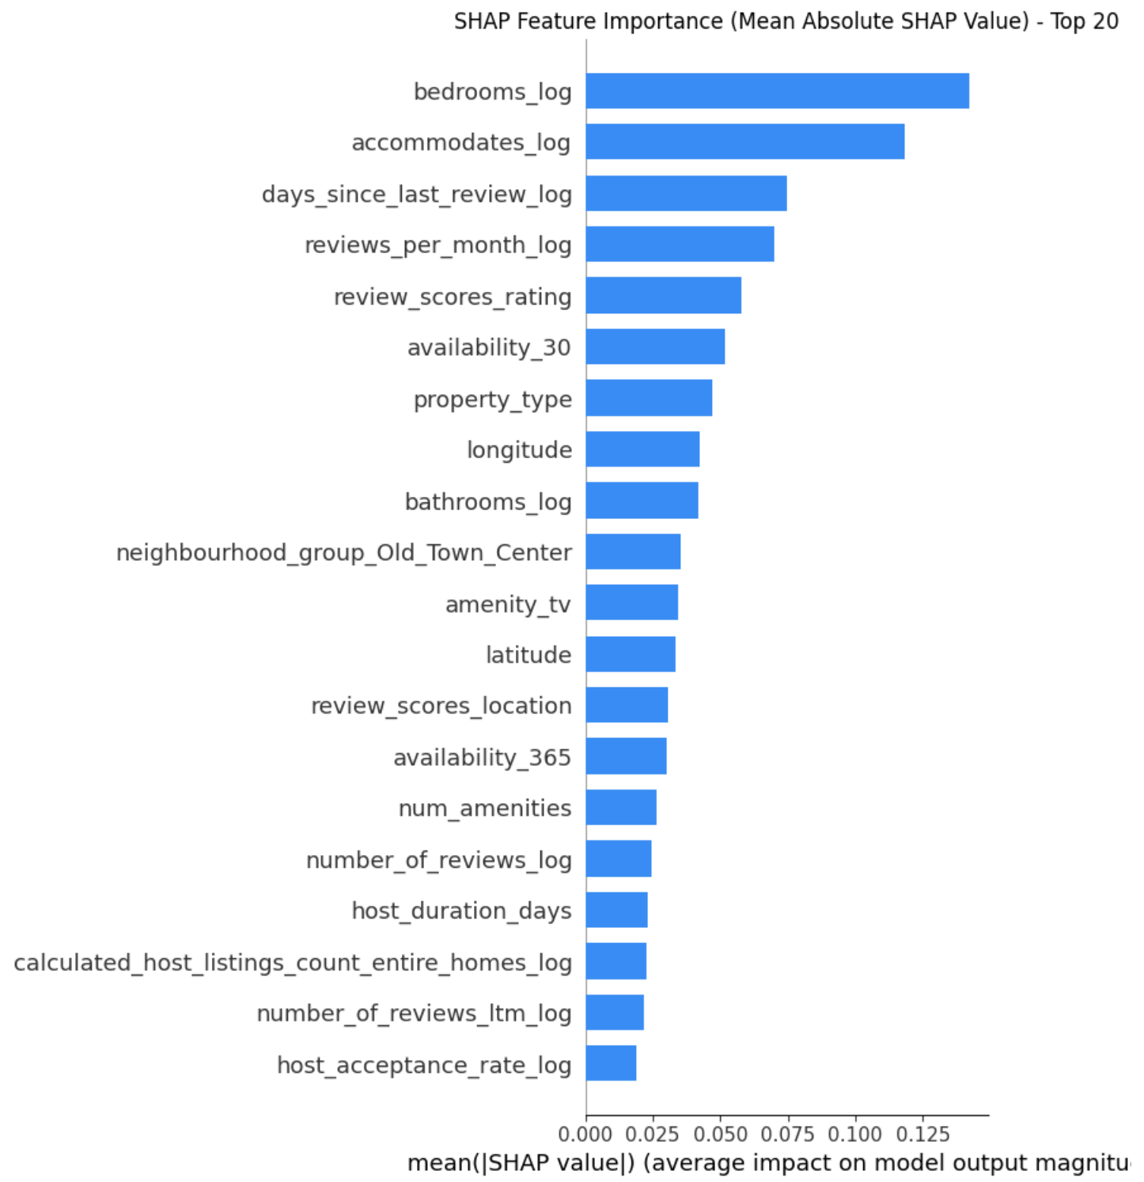
SHAP – feature importance

Slide 14
Streamlit APP

Slide 15
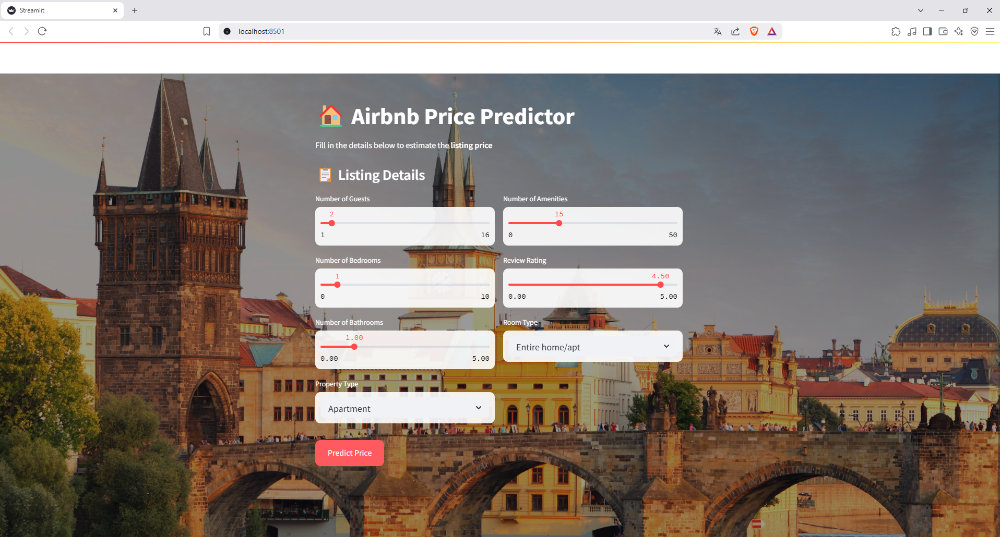
Preview

Slide 16
BONUS

Slide 17
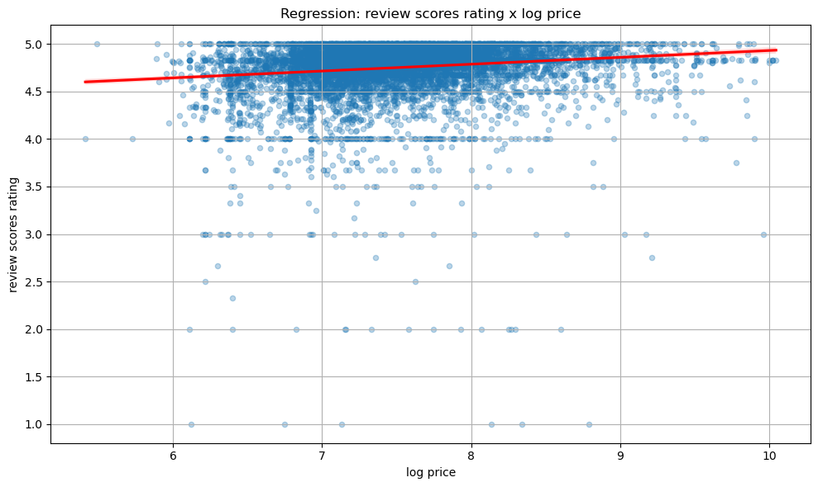
Relation between the sentiment and price
Higher prices are only slightly associated with higher ratings
Pearson: 0.1469 (p-hodnota = 2.7474e-43)
Spearman: 0.2062 (p-hodnota = 2.2404e-84)

Slide 18
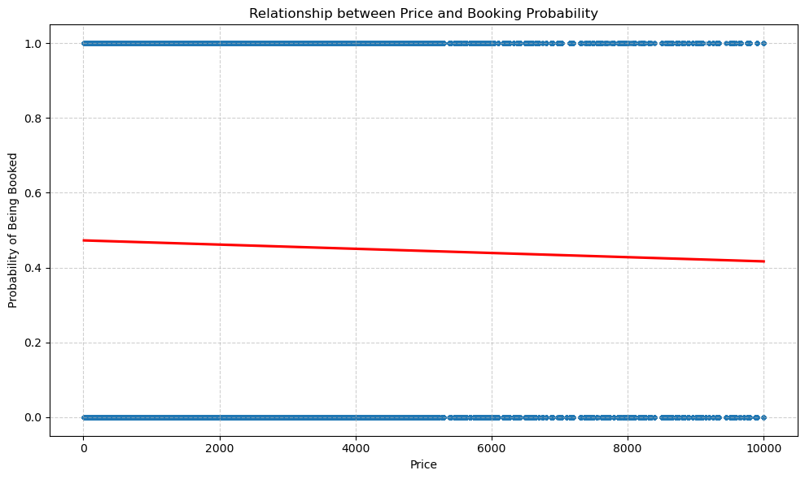
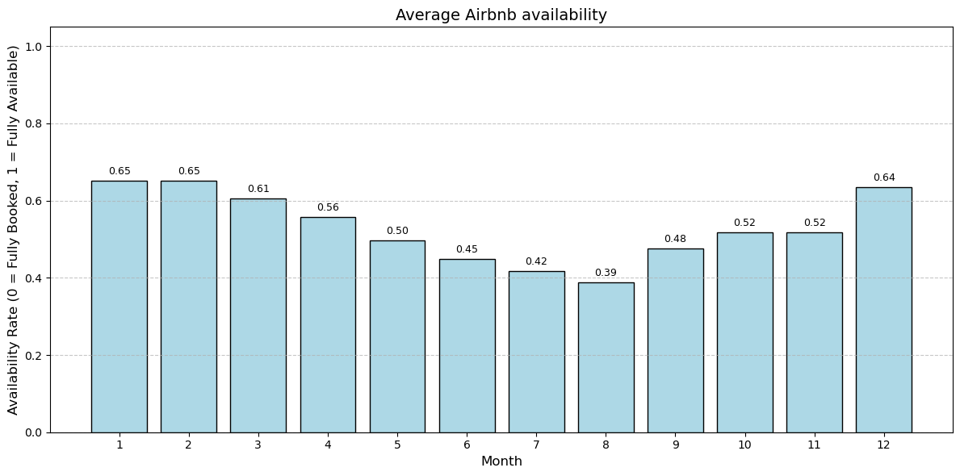
High seasons
Highest demand - July and August, indicating peak season.
These trends suggest summer months are the most active for short-term rentals.
Reserved days have lower average prices than available ones.

Slide 19
Thank for your attention
Dominik Nováček
Juraj Šlauka
Richard Kalousek
Viktor Sívek
Vojtěch Neumann

